Slide 1



Advanced Topics Lesson
Presentation
Student Performance Data Set
Nuriye Merve Tatlıdil
150212002

Slide 2
Timeline
Data Set Information
Data Preprocessing
Step
Algorithms
Algorithm Results.
Evaluation

Slide 3

Data Set Information
-This data approach student achievement in secondary education of two Portuguese schools. The data attributes include student grades, demographic, social and school related features.
-Data set has 395 Instances, 33 attributes.There
are 30 social qualities in 33 attributes. The other
2 qualities are midterm points and the final score
is the final grade.
-MY GOAL: To determine the letter grade
according to the final grade.
15-20 : A
10-15 : B
5-10 :C
0- 5 :D

Slide 4

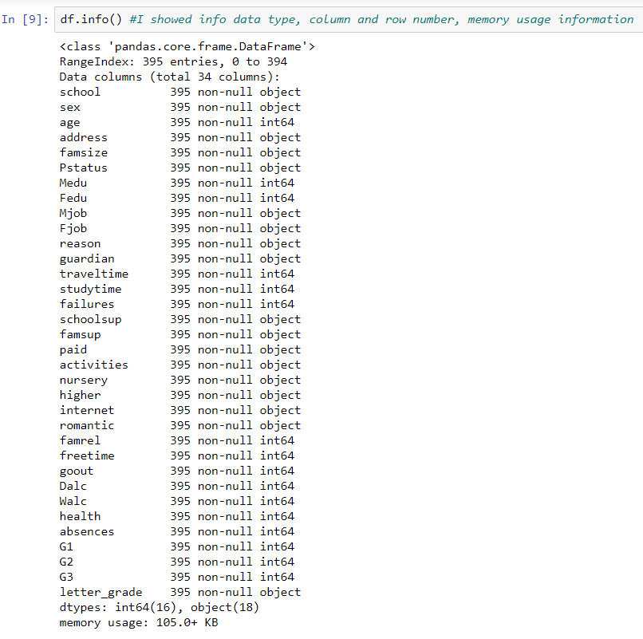
Data Types Information

Slide 5


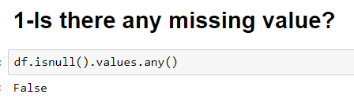
Missing Data

Slide 6

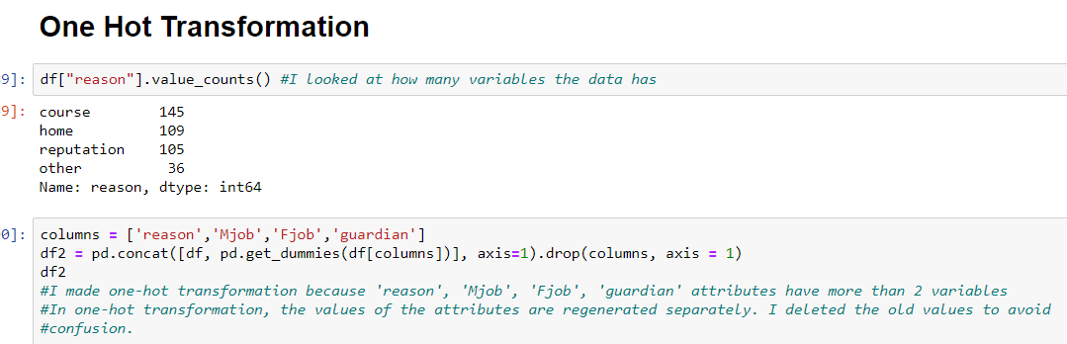
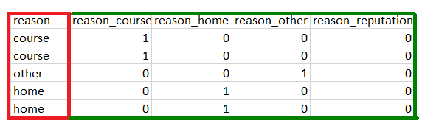
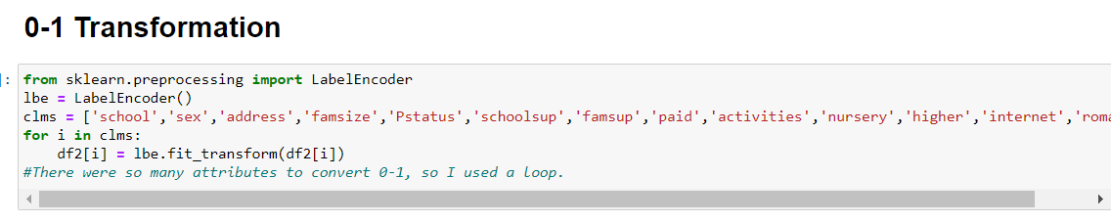
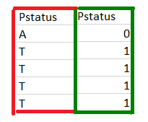
Data Transformation
FIRST LAST
FIRST LAST

Slide 7

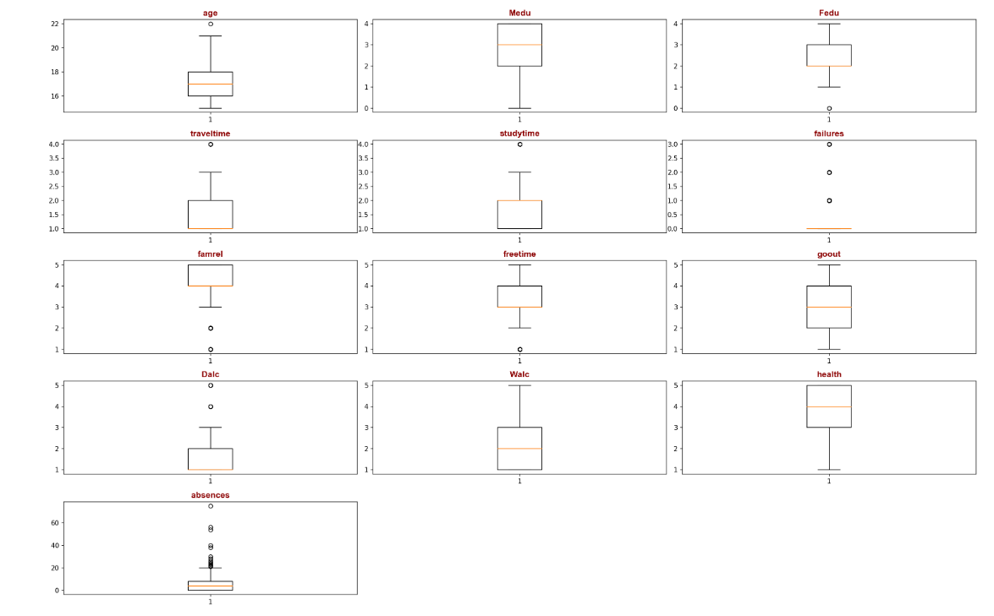
Outlier Data
Nothing
Higher
Lower

Slide 8

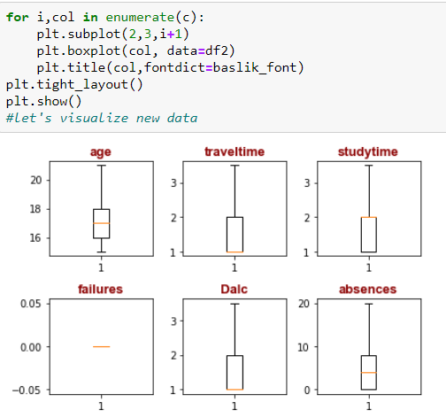
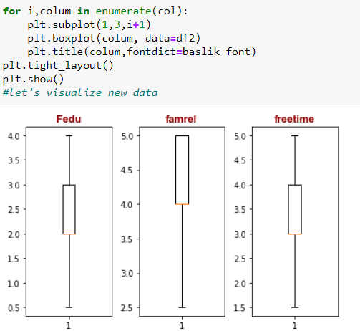
Suppression Method
Higher
Lower

Slide 9
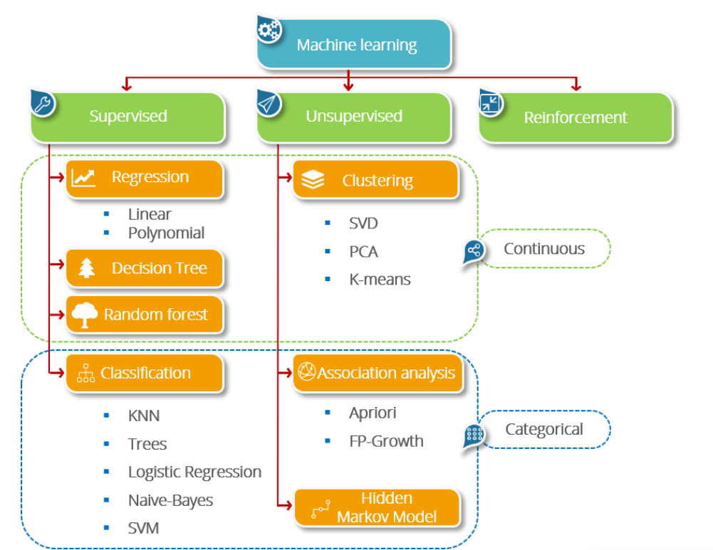
% 70 TRAIN
% 30 TEST
STRATIFIED K FOLD
CROSS VALIDATION

Slide 10
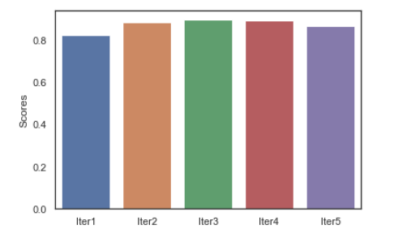
KNN Iteration
%89.8
%87
%89.7
%82.7
MEAN : %87.6
%88.7

Slide 11

Naive Bayes Evalution
Algorithm | Accuracy
1 Writing %82.3
2 With Sklearn %84
With 5 Fold %83.1
Cross Validation
4 Without g1,g2,g3 %25.9
attributes

Slide 12
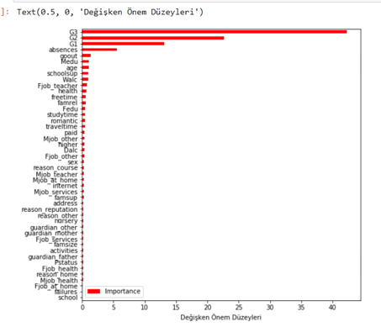
Random Forest : Variable Significance Levels

Slide 13

Algorithm Evalution
Algorithm | Accuracy
1 KNN %87
2 Naive Bayes %79
3 SVM %99.9
4 Random Forest %94

Slide 14

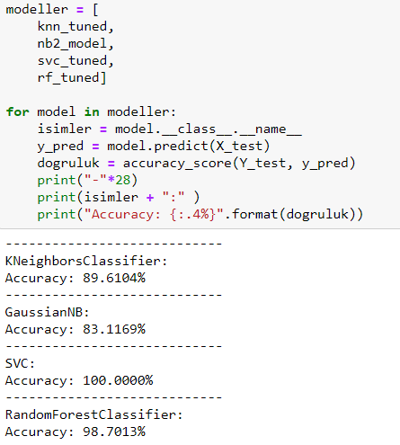
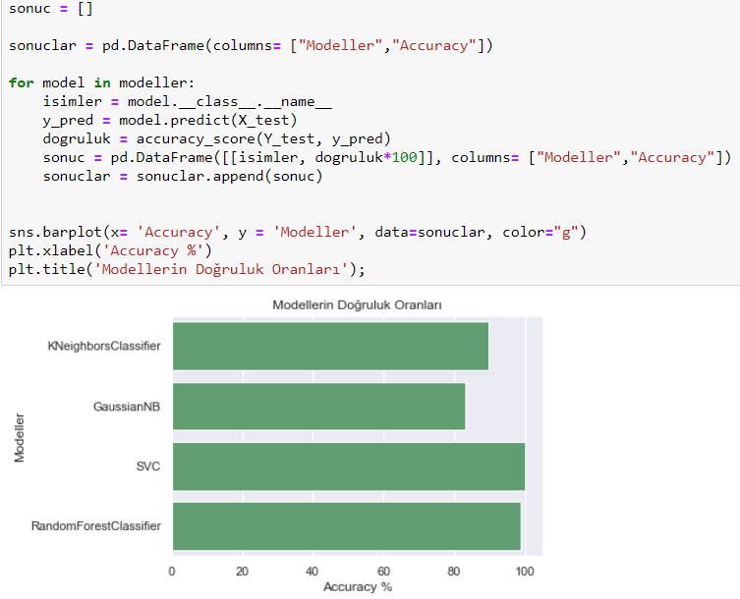
Model Tuning Evalution

Slide 15

Without G1,G2,G3 Evalution
Algorithm | Accuracy
KNN %43.7
Naive Bayes %25.9
SVM %45.9
Random Forest %43.8

Slide 16

Thank you

